Slide 1
Index laws
Year 9

Slide 2
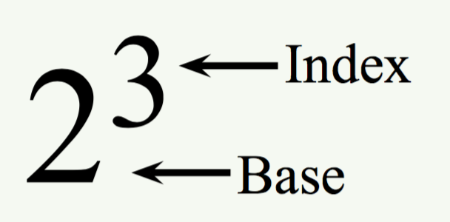

Title: What are indices?
EQ: What are the index laws, and how do we use them to solve problems.
Questions:
Notes:
An index has many names, such as powers, squares(2) and cubes(3)
So how do we use them?
Indices have two parts- the index and the base:
Lets revise: $x+x=2x$, while $x × x=x^{2}$ Notice the difference?
When you multiply together the same variable, it creates an index- this means that if you multiply two of the same variable together, you get and index of 2, three of the same variables you get 3…
Also remember: $x$ and $x^{2}$ are different, so you cannot add(+) or subtract (-) them.
What is an index?
What is a like term

Slide 3
Title: What are indices?
EQ: What are the index laws, and how do we use them to solve problems.
Questions:
Notes:
There are laws that govern how we solve problems with indices, these are called index laws.
Index law 1:a^{m} x a^{n} = a^{m+n}
When multiplying two indices together, you add them – you can only add like bases
y³ x y⁴
= y³⁺⁴
=y⁷
REMEMBER: if there is and “a” and a “b”, only multiply “a” by “a” and “b” by “b” eg:
a⁴b³ x a²b becomes a⁴ x a² x b³ x b =
= a⁴⁺² x b³⁺¹
⁼ a⁶b⁴

Slide 4

Title: What are indices?
EQ: What are the index laws, and how do we use them to solve problems.
Questions:
Notes:
Index law 2: $a^{m} ÷a^{n }$= $a^{m −n}$
Multiplication and division are opposites in mathematics, and in index laws
When dividing the same bases, subtract the indices
Fractions are also governed by index law 2
$\frac{x^{7}}{x^{3}}$
= $x^{7 }÷x^{3}$
= $x^{7−3}$
=$x^{4}$

Slide 5

Guided Practise
Solve the following problems using index laws 1 and 2:
y² x y⁴ = a³b³ x a²b³ =
y¹² $÷$ y²= $\frac{\text{a}\text{10}\text{b}\text{6} }{\text{a}\text{3}\text{b}}$=

Slide 6
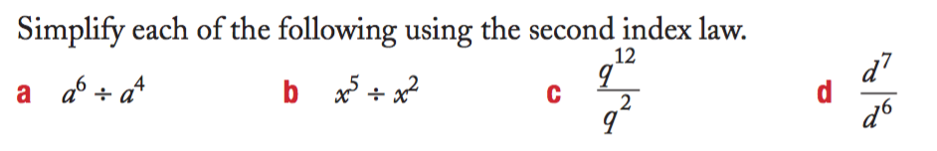
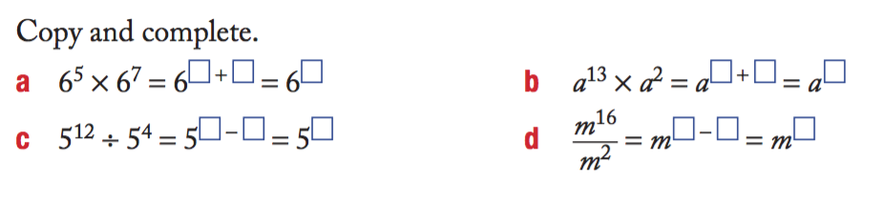
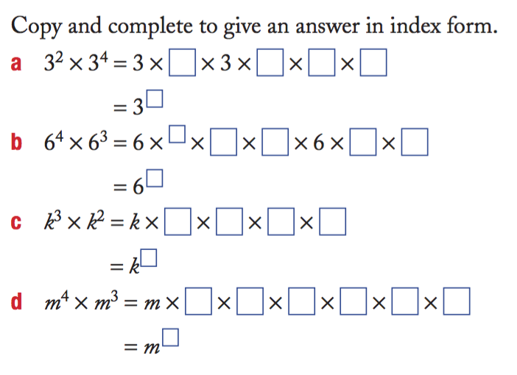
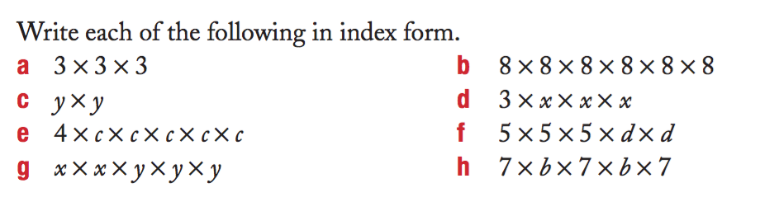
You do

Slide 7
How do we feel?
With a show of thumbs, what level of confidence do we have?
Thumbs up – All good, no issues
Thumbs middle – I’m still unsure of the index laws 1 and 2
Thumbs down – I have no idea.

